Slide 1
CSMA (without or with CD) & Collision-Free Protocols

Slide 2
Carrier Sense Multiple Access (CSMA)
What if we sense the channel before TX?
1-persistent CSMA. Sense the channel, then:
If channel free, transmit
If channel busy, keep sensing till free, then send immediately (greedy)
Non-persistent CSMA. Sense the channel:
If channel free, transmit (same as 1-persistent)
If channel busy, wait random time before retrying

Slide 3
Carrier Sense Multiple Access (CSMA)
p-persistent CSMA – Slotted designs only
If channel free, TX with probability p. Or wait for next time slot with probability 1-p. At the start of the next time slot apply the same logic.
If channel busy, wait for a random period of time

Slide 4
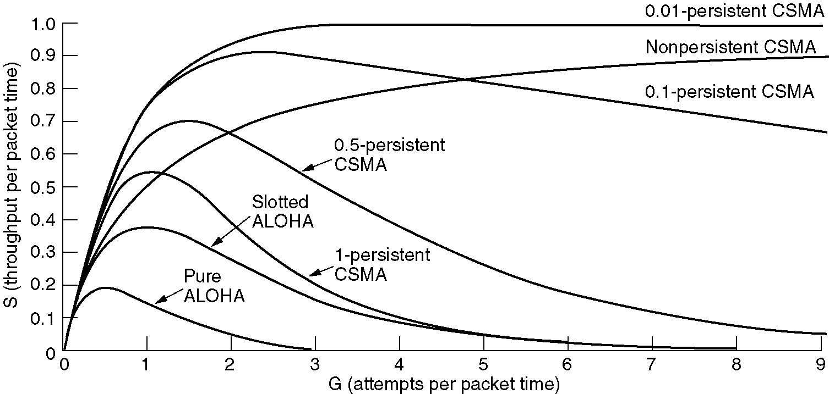
Persistent & Nonpersistent CSMA
CSMA outperforms ALOHA. Less persistent (lower p), better performance under high load.

Slide 5
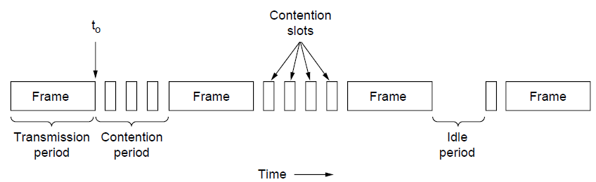
CSMA with Collision Detection
CSMA/CD improvement: Early abort of TX if a collision is detected

Slide 6
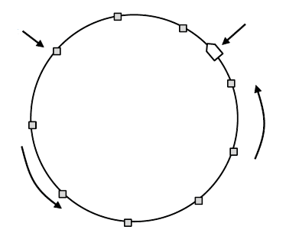
Collision-Free protocols
Avoid collisions altogether
Senders must know when to TX
Examples:
Bitmap
Token Ring
Binary Countdown
Token
Station
Direction of
transmission
Token ring

